Slide 1

Interactive Proof
Instructor: Kuan Cheng

Slide 2
Interactive Proof
Standard Proof
Interactive Proof
Different models of IP
Basic properties

Slide 3
Proofs
Standard proof: certificate based definition of NP.
Prover: provides a proof written on a paper.
Verifier: checks the proof is valid.
Is this the only way of doing proofs?

Slide 4
Interactive Proofs
Imagine you are at a court/thesis defense…
A series of questions/answers alternate.
The proof becomes interactive.
Verifier asks questions while prover provides answers, until the verifier is convinced.

Slide 5
Interactive Proofs
Interactive proofs are a generalization of NP.
Question: what is the power of interactive proofs?
Example: can we provide a short interactive proof for ψ ∈ ¬ SAT (coNP-complete)?
How about ψ ∈ TQBF (PSPACE-complete)?

Slide 6
Interactive Proofs
Try to formalize interactive proofs.
Verifier: conducts an interrogation by repeatedly asking questions, decides in the end.
Prover: provide responses.
The message of each party can depend on all previous messages

Slide 7



Example
A red cake and a green cake
Alice
Bob
Bob is color blinded so he thinks the two pies are the same
Alice tries to convince Bob that the two pies are different, how?

Slide 8
Example
A red cake and a green cake
Alice
Bob
Bob does the following: switch the order of the two pies arbitrarily without letting Alice see the switch. Then ask Alice if he made a switch.
After Bob finishes, Alice answers Bob’s question.

Slide 9
Example
A red cake and a green cake
Alice
Bob
After say 100 times of this experiment, if Alice always answers correctly, then Bob should be pretty convinced that the two pies are different.
If the two pies are indeed identical, then it’s extremely unlikely Alice can answer correctly in all 100 experiments.

Slide 10
A closer look at the example
Alice is more powerful than Bob.
Alice can convince Bob the two pies are different without telling him what’s the difference (zero-knowledge proof).
What’s the key ingredient used here?
Bob’s “arbitrary” choice of switching without Alice knowing it

Slide 11
Interactive Proofs
Generally, assume the prover to be all powerful (can solve anything).
Prover: deterministic or probabilistic?
Verifier: deterministic or probabilistic?
If allow probabilistic prover/verifier, how to define “accept” and “reject”?

Slide 12
Deterministic Interactive Proofs (DIP)
Both prover and verifier are deterministic.
Simple Example: DIP for ψ ∈ SAT.
one-round interaction
Verifier: It outputs 1 iff ψ ∈ SAT. Receive variable evaluations and check.
Prover: Convince the verifier. Send variable evaluations.

Slide 13
Deterministic Interactive Proofs (DIP)

Slide 14
Deterministic Interactive Proofs (DIP)

Slide 15
Deterministic Interactive Proofs (DIP)

Slide 16
Deterministic Interactive Proofs (DIP)

Slide 17
Deterministic Interactive Proofs (DIP)

Slide 18
IP: Probabilistic Verifier
To make the class IP more interesting, need to change prover/verifier.
Changing prover to be probabilistic does not change the power of IP.
Since the prover is already all powerful.
Changing the verifier to be probabilistic.

Slide 19
IP: Probabilistic Verifier
What does it mean to change the verifier to be probabilistic?
The verifier’s questions will be computed using a probabilistic algorithm.
Verifier will be allowed to come to a wrong conclusion with some small probability.
The probability is over the verifier’s random bits used.

Slide 20
IP: Probabilistic Verifier

Slide 21
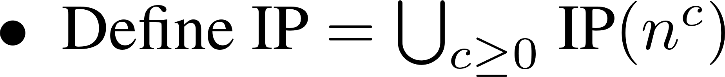
Definition of IP

Slide 22
Basic Properties of IP

Slide 23
Basic Properties of IP

Slide 24
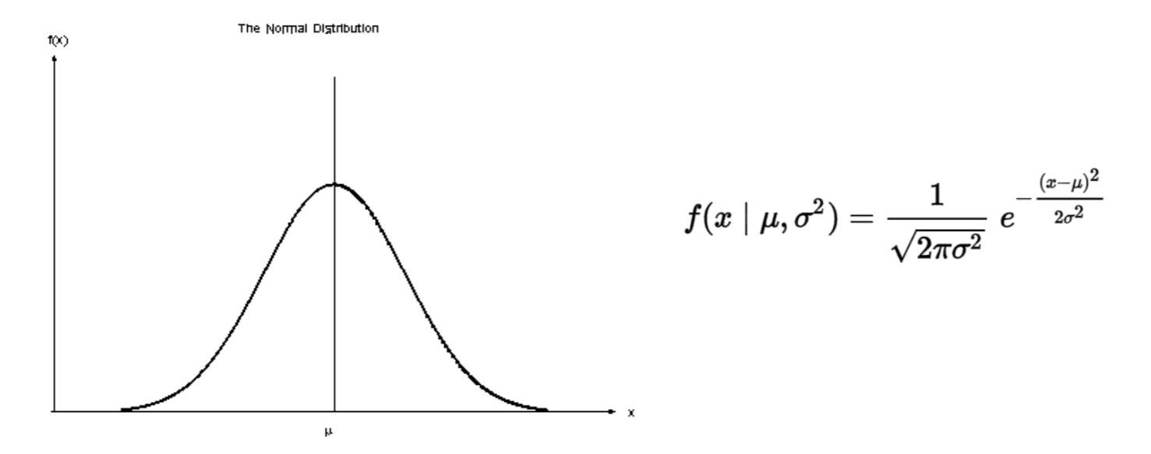
Basic Properties of IP

Slide 25
Basic Properties of IP

Slide 26
Basic Properties of IP
The prover can be very powerful, but is it really necessary?
Turns out it is enough to use a prover in PSPACE.
Since a PSPACE prover can compute the optimal answers.
In other words, we show IP ⊆PSPACE.

Slide 27
IP ⊆PSPACE

Slide 28
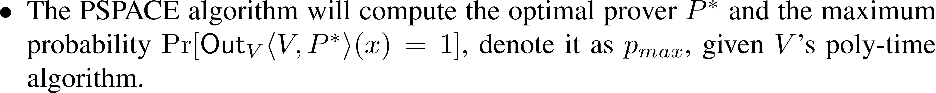
IP ⊆PSPACE

Slide 29
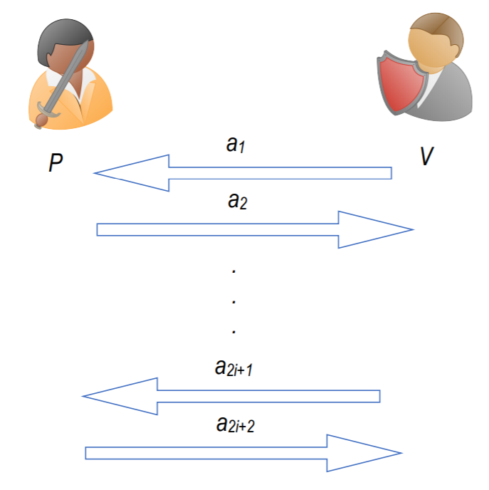
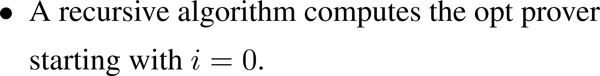
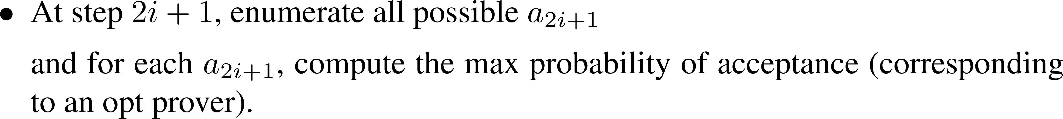
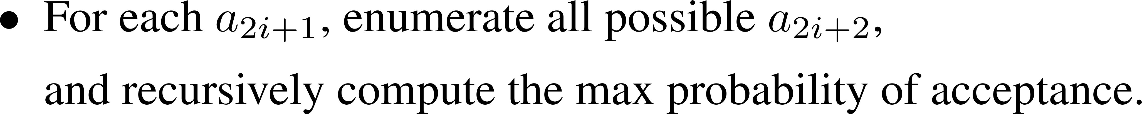
IP ⊆PSPACE

Slide 30
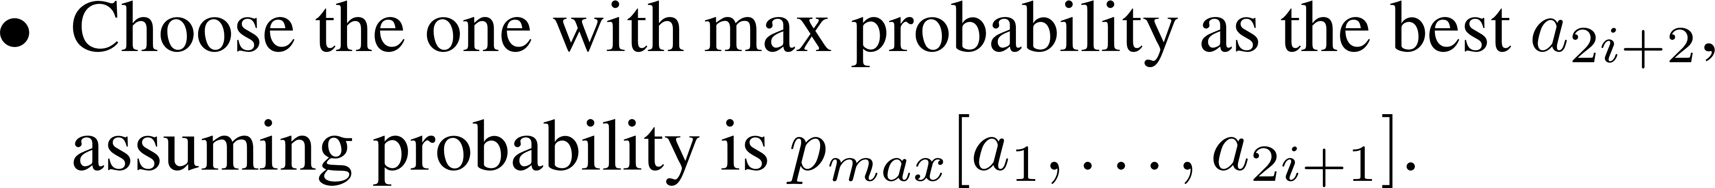
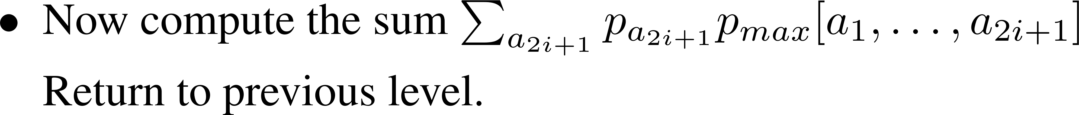
IP ⊆PSPACE

Slide 31
Graph Non-Isomorphism

